Slide 1
States of matter
Year 7 Science

Slide 2
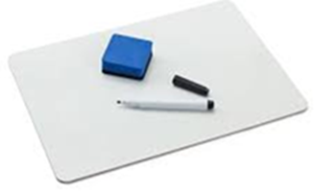
Lab Vocab
corrosion
acidic
transparent
volatile
texture
explosive
mixture
flammable
substance
soluble

Slide 3
Learning Intentions
Mixtures, including solutions, contain a combination of pure substances that can be separated using a range of techniques.

Slide 4
Success criteria
Describe the properties of solids, liquids and gases.
Classify examples as solids, liquids or gases.

Slide 5
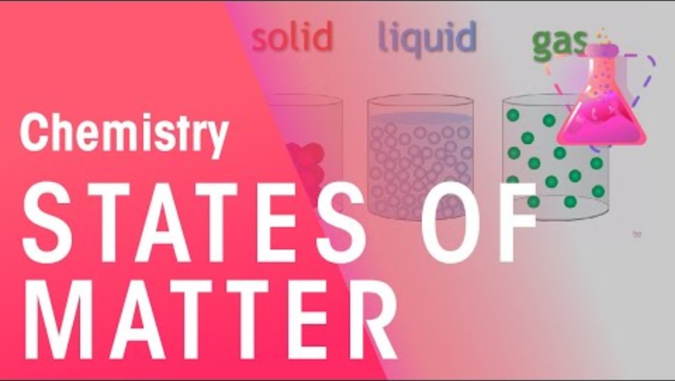

Slide 6
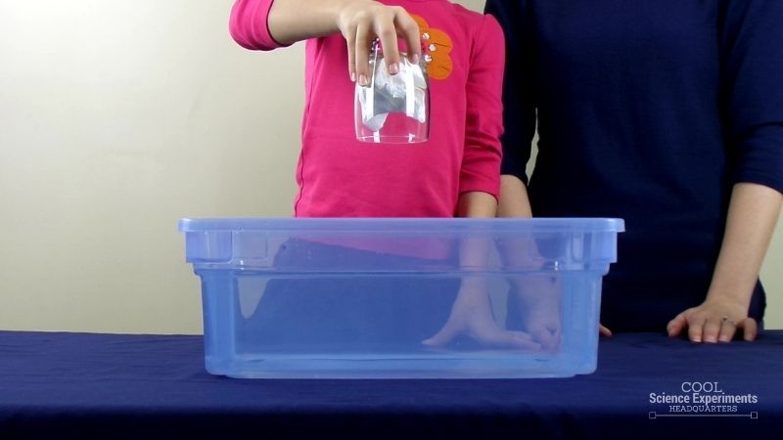
Activity: Solids, liquids, gases

Slide 7
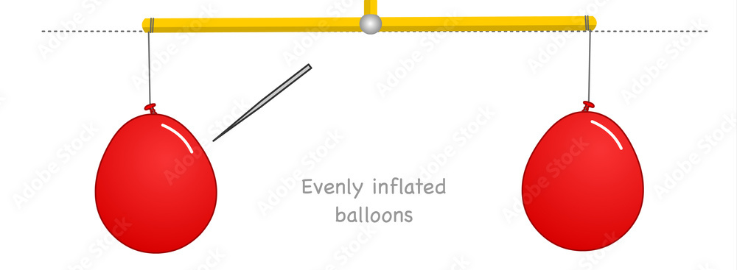
Activity 2 : Weighing a gas

Slide 8
Don’t forget
Diaries Monday!
Last call for Invertebrates Assignments

Slide 9
Success criteria
Describe the properties of solids, liquids and gases.
Classify examples as solids, liquids or gases.

